Slide 1
Opening our Eyes to the Cosmos:
A Catholic Scientific Perspective
Science and Religion

Slide 2

Science cannot disprove God, anymore than science can prove God.
Questions of God’s existence go beyond the physical: the test-tube, the microscope, and the telescope.

Slide 3

There are numerous references in the Bible, and statements made by the
Church, Catholic leaders,
and scientists of faith affirming the harmony of science and theology.

Slide 4
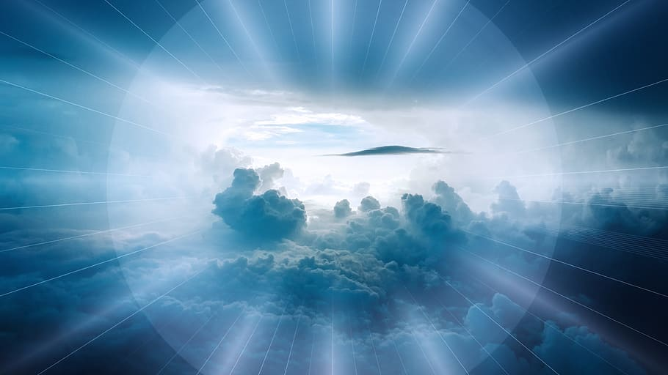
Psalm 8
Lord, our Lord, how majestic is your name in all the earth!
You have set your glory in the heavens...
When I consider your heavens, the work of your fingers,
the moon and the stars, which you have set in place,
what is mankind that you are mindful of them, human beings that you care for them?
(verses 1-5)

Slide 5
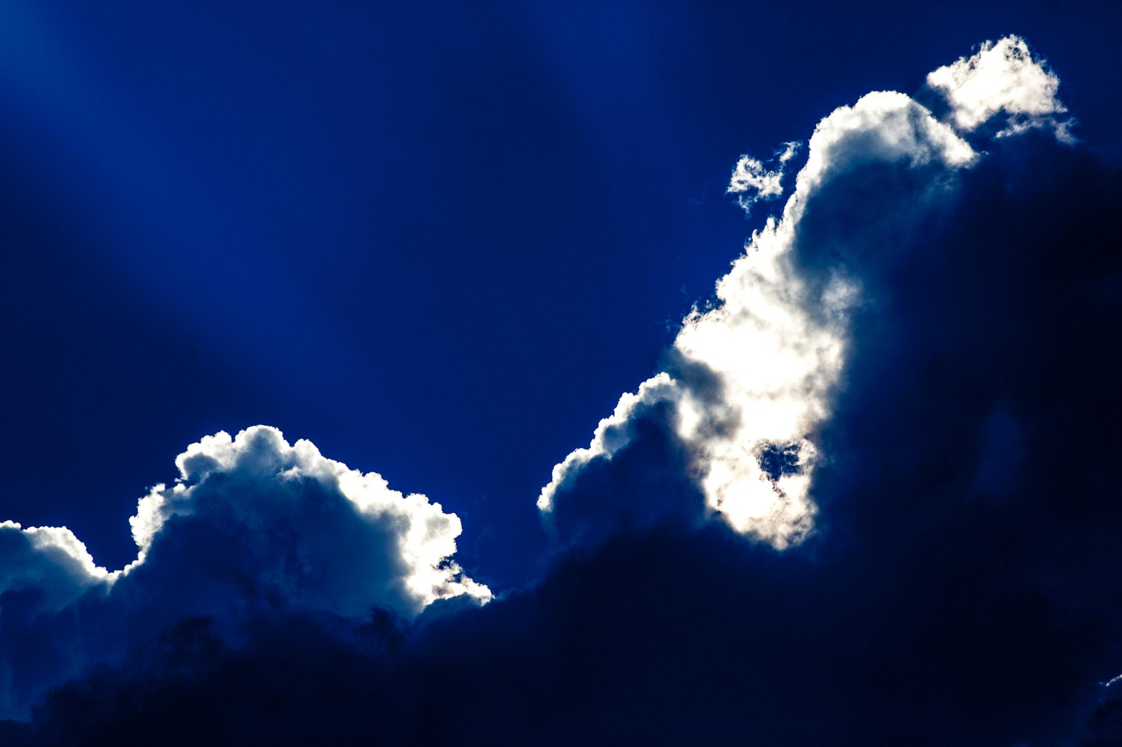
I
Psalm 102
In the beginning you laid the foundations of the earth,
and the heavens are the work of your hands.
They will perish, but you remain;
they will all wear out like a garment.
Like clothing you will change them
and they will be discarded.
But you remain the same,
and your years will never end.
(verses 25-27)

Slide 6

What Jesus says?
Matthew Chapter6:25-34
25 Therefore I say unto you, Be not anxious for your life, what ye shall eat, or what ye shall drink; nor yet for your body, what ye shall put on. Is not the life more than the food, and the body than the raiment? 26 Behold the birds of the heaven, that they sow not, neither do they reap, nor gather into barns; and your heavenly Father feedeth them. Are not ye of much more value than they? 27 And which of you by being anxious can add one cubit unto [a]the measure of his life? 28 And why are ye anxious concerning raiment? Consider the lilies of the field, how they grow; they toil not, neither do they spin: 29 yet I say unto you, that even Solomon in all his glory was not arrayed like one of these. 30

Slide 7

“… there can never be a real conflict between faith and reason, since the same God
who reveals mysteries and infuses faith has bestowed the light of reason on the human mind.”
--Vatican I (1869-1870)

Slide 8
Catechism of the Catholic Church
159 Faith and science:
"Though faith is above reason, there can never be any real discrepancy between faith and reason. Since the same God who reveals mysteries and infuses faith has bestowed the light of reason on the human mind, God cannot deny himself, nor can truth ever contradict truth."³⁷ "Consequently, methodical research in all branches of knowledge, provided it is carried out in a truly scientific manner and does not override moral laws, can never conflict with the faith, because the things of the world and the things of faith derive from the same God. the humble and persevering investigator of the secrets of nature is being led, as it were, by the hand of God in spite of himself, for it is God, the conserver of all things, who made them what they are."³⁸

Slide 9

Pope Francis
Saint Francis, faithful to Scripture, invites us to see nature as a magnificent book in which God speaks to us and grants us a glimpse of his infinite beauty and goodness. “Through the greatness and the beauty of creatures one comes to know by analogy their maker” (Wis 13:5); indeed, “his eternal power and divinity have been made known through his works since the creation of the world” (Rom 1:20).

Slide 10
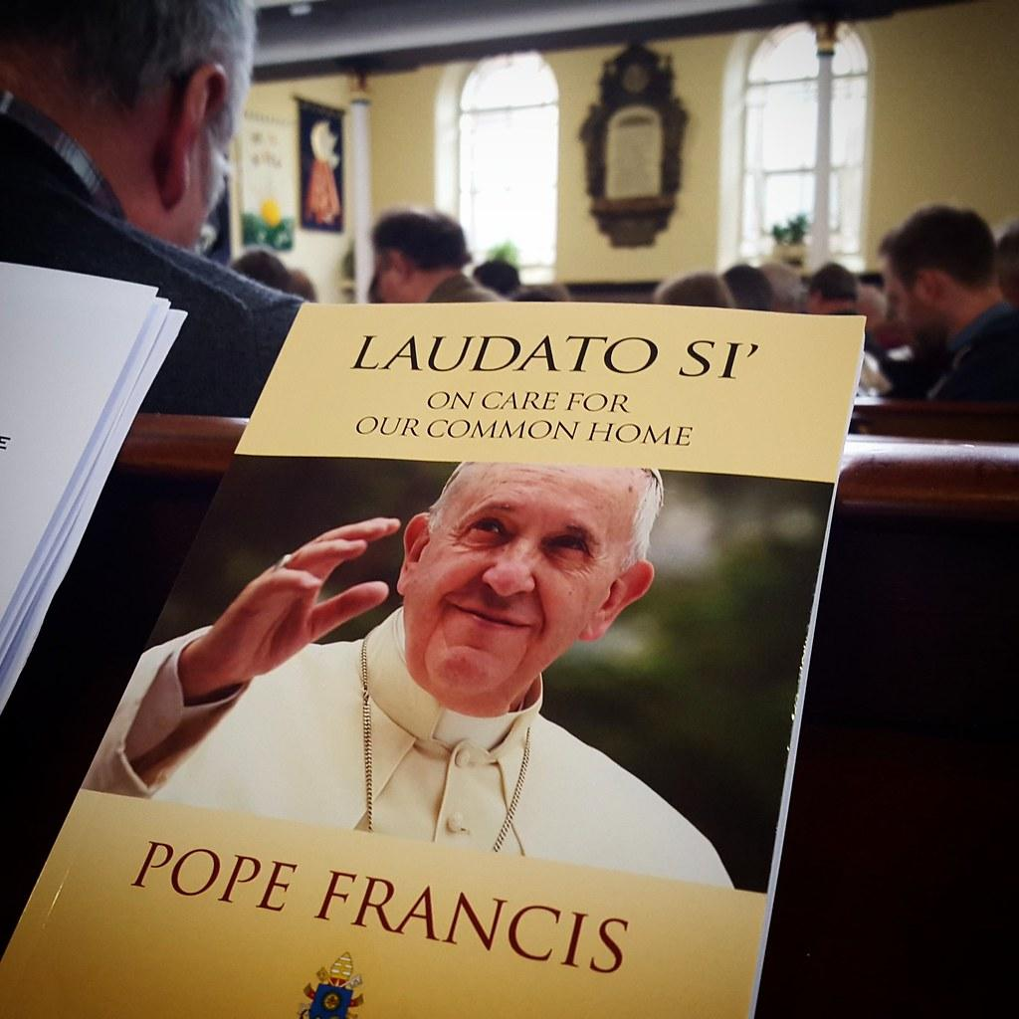
We are not God. The earth was here before us and it has been given to us. vs.67
The Psalms frequently exhort us to praise God the Creator, “who spread out the earth on the waters, for his steadfast love endures for ever” (Ps 136:6). They also invite other creatures to join us in this praise: “Praise him, sun and moon, praise him, all you shining stars! Praise him, you highest heavens, and you waters above the heavens! Let them praise the name of the Lord, for he commanded and they were created” (Ps 148:3-5). Vs.72
199. It cannot be maintained that empirical science provides a complete explanation of life, the interplay of all creatures and the whole of reality. This would be to breach the limits imposed by its own methodology. If we reason only within the confines of the latter, little room would be left for aesthetic sensibility, poetry, or even reason’s ability to grasp the ultimate meaning and purpose of things.
201.The majority of people living on our planet profess to be believers. This should spur religions to dialogue among themselves for the sake of protecting nature, defending the poor, and building networks of respect and fraternity. Dialogue among the various sciences is likewise needed, since each can tend to become enclosed in its own language, while specialization leads to a certain isolation and the absolutization of its own field of knowledge. This prevents us from confronting environmental problems effectively. An open and respectful dialogue is also needed between the various ecological movements, among which ideological conflicts are not infrequently encountered.
ENCYCLICAL LETTER, LAUDATO SI’

Slide 11
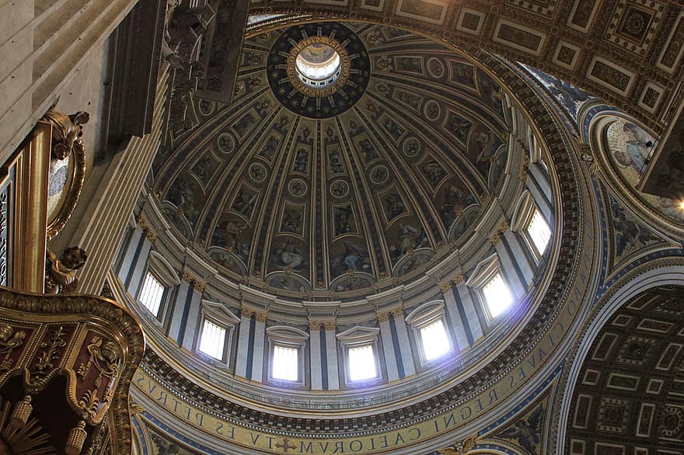
159. Faith and science: "... methodical research in all branches of knowledge, provided it is carried out in a truly scientific manner and does not override moral laws, can never conflict with the faith,
because the things of the world and the things of faith derive from the same God. The humble and persevering investigator of the secrets of nature is being led, as it were, by the hand of God in spite of himself, for it is God, the conserver of all things, who made them what they are." (Vatican II GS 36:1)

Slide 12
Furthermore, there are many Catholic and Protestant scientists, who have contributed to the advancement of science and who saw no incongruity between their faith and their work.

Slide 13
Many of the great founders of modern science, including Copernicus, Galileo, Kepler, and Newton were all deeply religious people of faith.

Slide 14
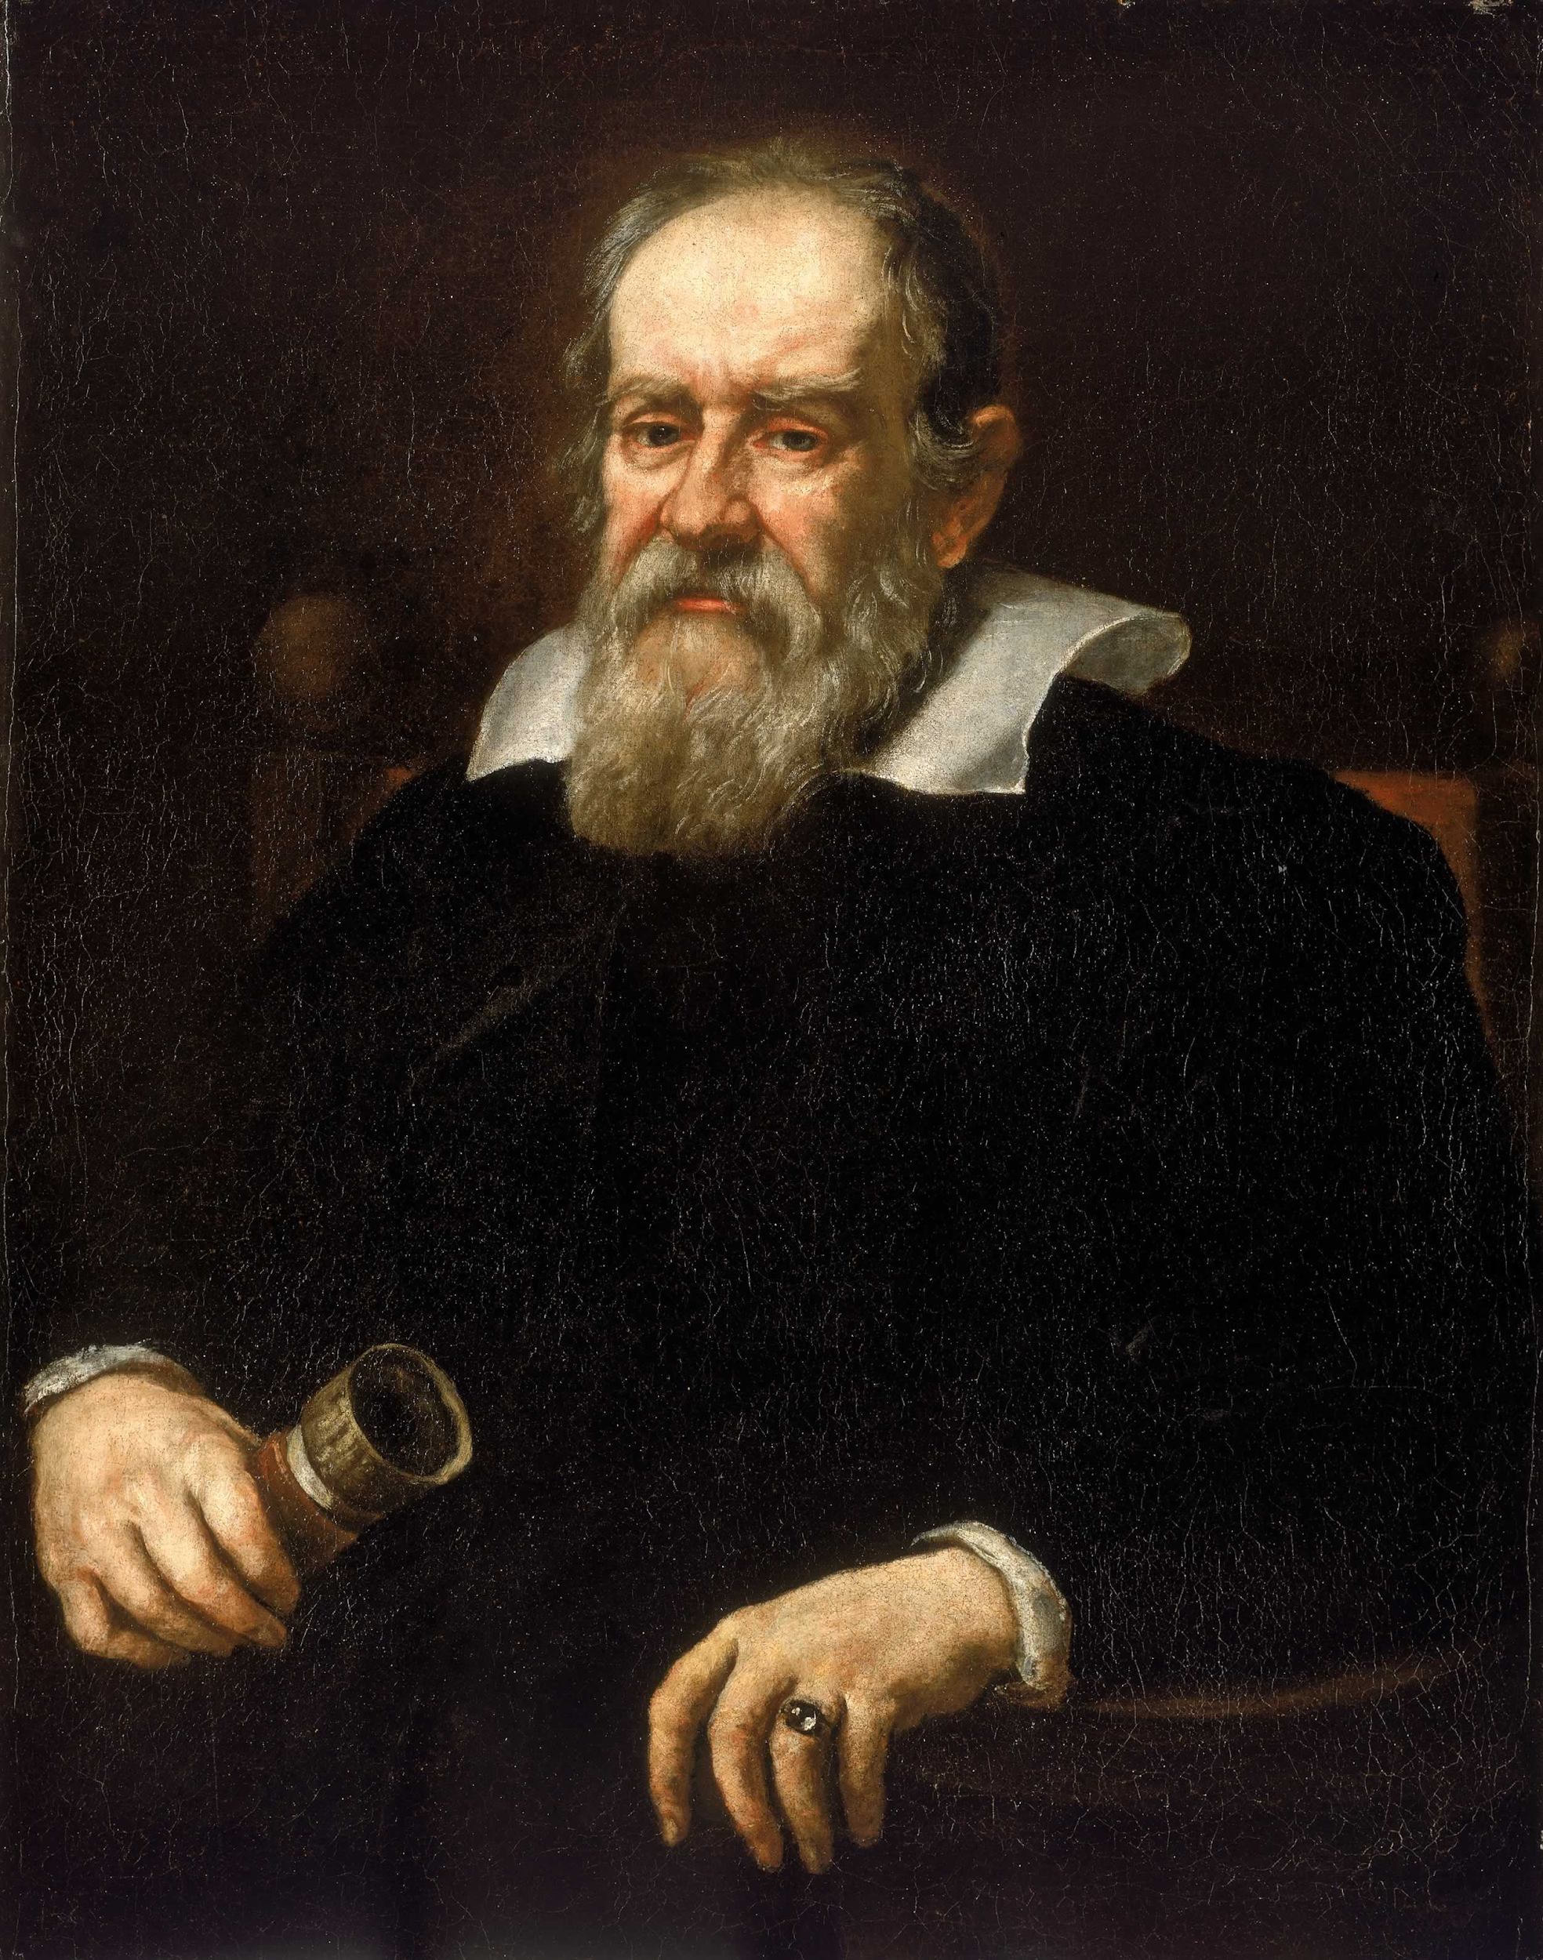
“I give infinite thanks to God, who has been pleased to make me the first observer of marvelous things.”
“Mathematics is the language in which God has written the universe.”
“All truths are easy to understand once they are discovered; the point is to discover them.”
“It is surely harmful to souls to make it a heresy to believe what is proved.”
-Galileo Galilei

Slide 15
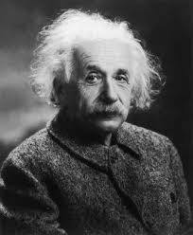
Albert Einstein
"Science without religion is lame, religion without science is blind."
“All religions, arts, and sciences are branches of the same tree”
“The more I study science the more I believe in God.”
“Coincidence is God's way of remaining anonymous.”
“The important thing is not to stop questioning. Curiosity has its own reason for existing.”

Slide 16
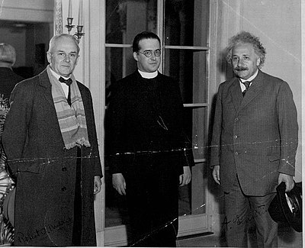
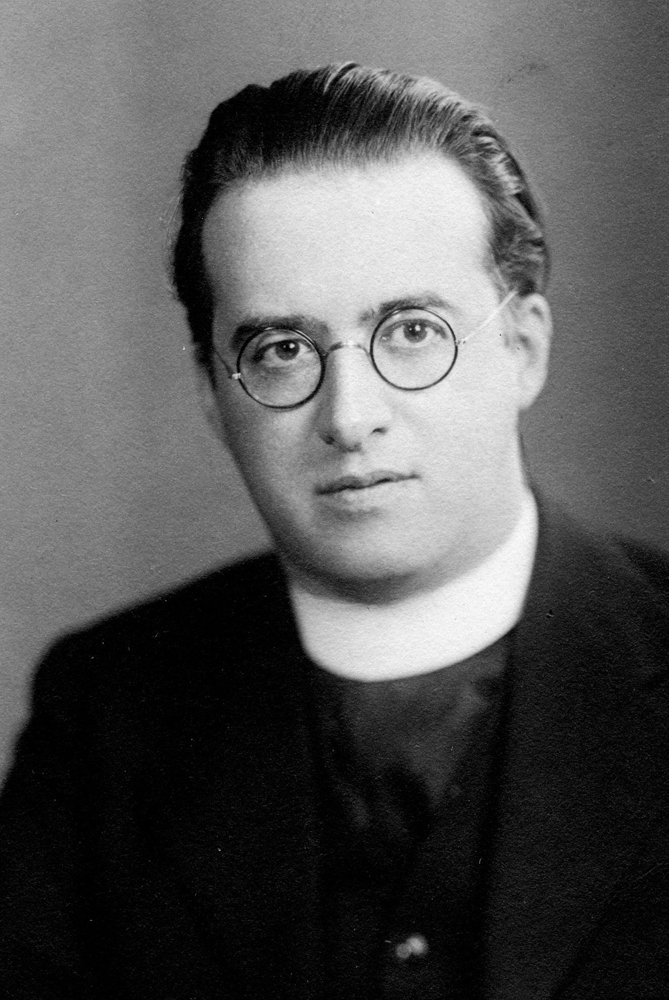
Monseigneur Georges Lemaître
“The Bible knows nothing about physics, and physics knows nothing about God.”
“The evolution of the world can be compared to a display of fireworks that has just ended: some few red wisps, ashes and smoke. Standing on a well-chilled cinder, we see the slow fading of the suns, and we try to recall the vanished brilliance of the origin of worlds.”

Slide 17
Robert Boyle
“God is the author of the universe, and the free establisher of the laws of motion.”(1627-1691)

Slide 18
Francis Collins
“I have found there is a wonderful harmony in the complementary truths of science and faith. The God of the Bible is also the God of the genome. God can be found in the cathedral or in the laboratory. By investigating God's majestic and awesome creation, science can actually be a means of worship.
“ I am a scientist and a believer, and I find no conflict between those world views.”

Slide 19
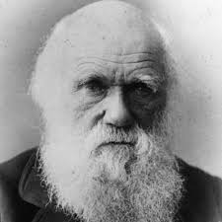
Charles Darwin
Darwin believed that God was the ultimate lawgiver, and believed in the existence of God as a First Cause and deserved to be called a theist.
“Among the scenes which are deeply impressed on my mind, none exceed in sublimity the primeval [tropical] forests, ... temples filled with the varied productions of the God of Nature. No one can stand in these solitudes unmoved, and not feel that there is more in man than the mere breath of his body.”
"The belief in God has often been advanced as not only the greatest, but the most complete of all the distinctions between man and the lower animals.”

Slide 20
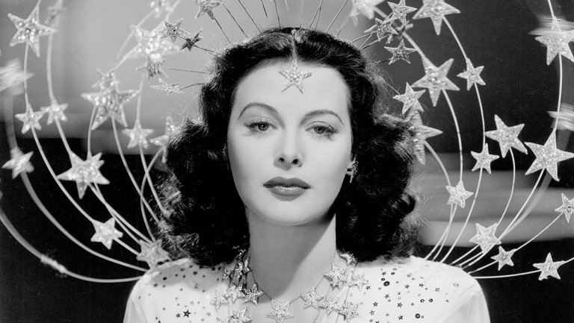
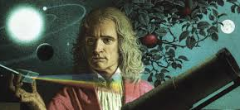
Hedy Lamarr
“I do believe in some grinding destiny that watches over us on earth. If it didn't, the safety valve would give and the boiler would explode.”
Sir. Isaac Newton
“Gravity explains the motions of the planets, but it cannot explain who sets the planets in motion.”

Slide 21
How? and Why? Example
“Science takes things apart to see how they work; religion brings things together to see what they mean.” (Jonathan Sacks) “The theological teaching of the Bible, like the doctrine of the Church… does not seek so much to teach us the how of things, as rather the why of things.” (St. John Paul II)
Science can explain the how but not always the why.
EXAMPLES: When listening to a new song, you may have two reactions: 1. What are the notes and chords? What key is it in? How do the instruments work together? What are the melodies and harmonies? 2. What emotions do I feel when I hear the song? Why do I like or not like it? What connections does it make to my life?
Reflect: Which do you connect with the most? #1 or #2?

Slide 22
Introduce the Video Clips and Movie
IN CLASS: (Disney +) Cosmos A Spacetime Odyssey, Episode 1 clips narrated by
Neil DeGrasse Tyson, an American Astrophysicist from New York City. This series explains many aspects of humans, earth, and the universe
HOMEWORK: Journey of the Universe (56 minutes)- Swimme connects such big picture issues as the birth of the cosmos 14 billion years ago — to the emergence of the first cell — as well as to our current impact on Earth's evolutionary dynamics. Through his engaging and thoughtful observations, audiences everywhere will discover the profound role we play in this intricate web of life.

